Slide 1

Onboarding – Objects
Looking back at objects and how they work
Trainer: Дарко Панчевски
Assistant: Наташа Панева

Slide 2
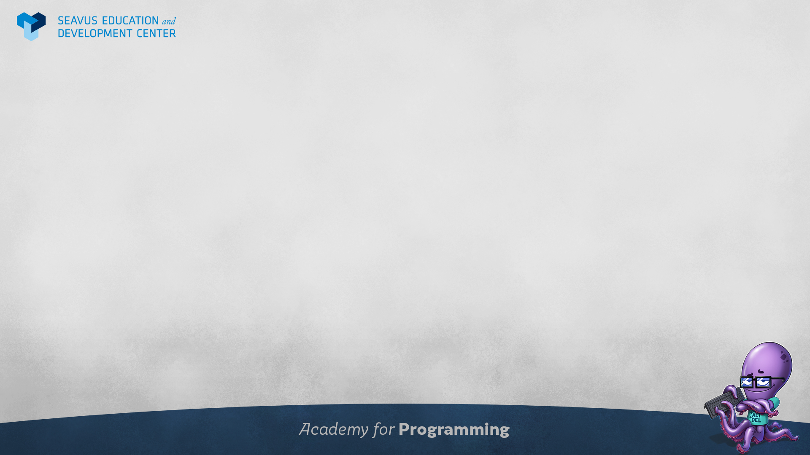
Class plan
Revisiting basic concepts of objects
Examples of objects
Exercises with objects

Slide 3
Looking back at Objects
Easy representation of human concepts in code
Organizing data easily
Objects can contain:
Properties
Methods
Objects can contain other objects and arrays

Slide 4
Uses of objects
Keeping data connected to a single entity
Organizing large amounts of data
Creating data structures similar to business logic

Slide 5

Questions?

